Slide 1
Bankruptcy Forecasting: A Predictive Analysis with SAS Enterprise Miner
Fall 2023 – MGMT 57100
Team: Data Jedi
Abhishek Krovvidi
Sai Teja Devalla
Sathwik Kanukuntla

Slide 2
Problem Objective
Project Overview:
Introduction of a predictive model aimed at forecasting bankruptcy risks in companies.
Key Features:
Utilization of 64 financial indicators.
Focus on profitability, liabilities, and asset management metrics.
Objective:
To offer a critical decision-making tool for stakeholders and financial analysts.
Impact:
Enhancing the identification of potential financial distress.
Assessing long-term viability of companies in the current economic environment.
Objective
Approach
Best
Model
Interpret
Learnings

Slide 3
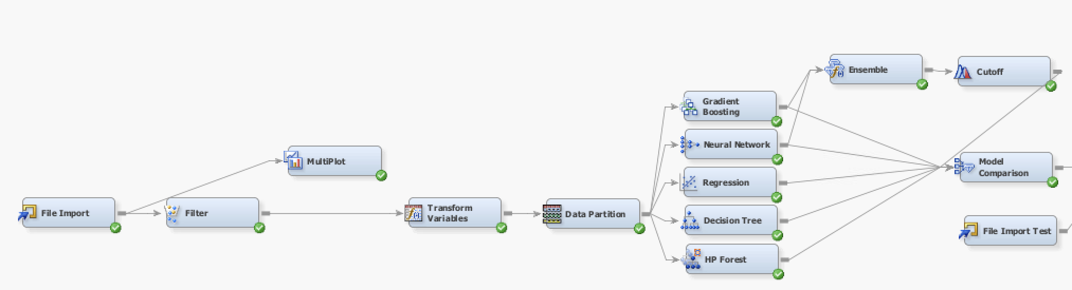
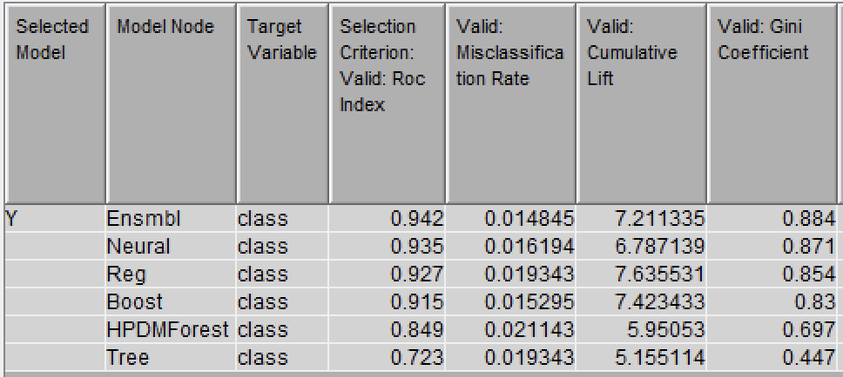
Our approach to evaluate different models
SEMMA
Sample
Explore
Modify
Model
Assess
Fit Statistics
Modelling techniques
Variable Transformation based on Skewness
Model comparison of different models
Tried Ensemble models with various combos
Assessed through various Cutoff values
Tuning model specific parameters across all the trials
Filtering outliers after exploring data through Multiplot
Objective
Approach
Best
Model
Interpret
Learnings

Slide 4
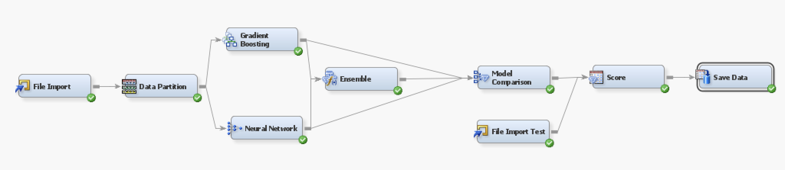
What is the best model we identified?
“Ensemble of Gradient Boosting and Neural Network models is our best predictive model”
Objective
Approach
Best Model
Interpret
Learnings

Slide 5
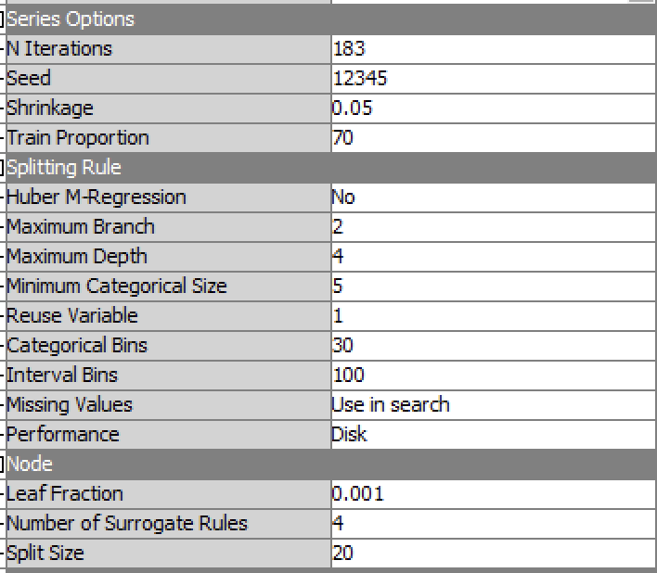
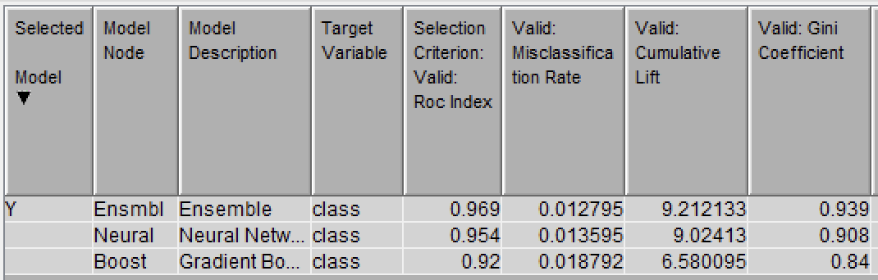

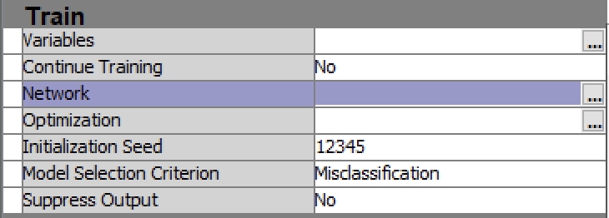
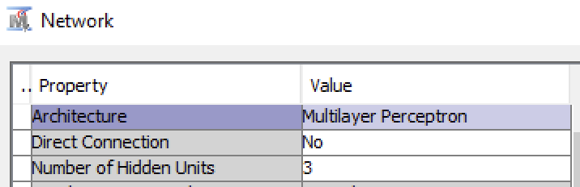
What is the best model we identified?
Gradient Boosting
Fit Statistics
Model Highlights
High Accuracy
Highly Reliable and Robust
High discriminatory power
9.2 X more effective prediction
Confident Future Predictions
Consistent Performance
Public dataset - 0.958%
Private dataset - 0.951%
Neural Network
Objective
Approach
Best Model
Interpret
Learnings
Notes:
Highly reliable Consistent performance across various thresholds and conditions.
Highly reliable and robust - balance between bias and variance, reducing the likelihood of overfitting
Gini effect close to 1 - a Gini coefficient of 0.939 signifies that the model is exceptionally good at predicting outcomes accurately

Slide 6
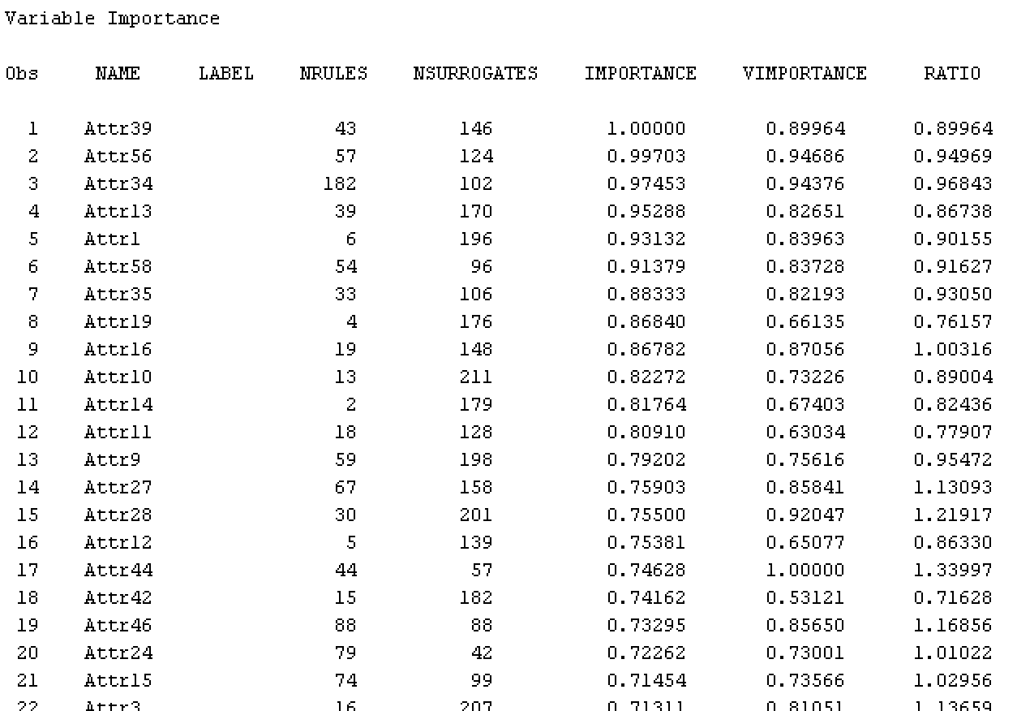
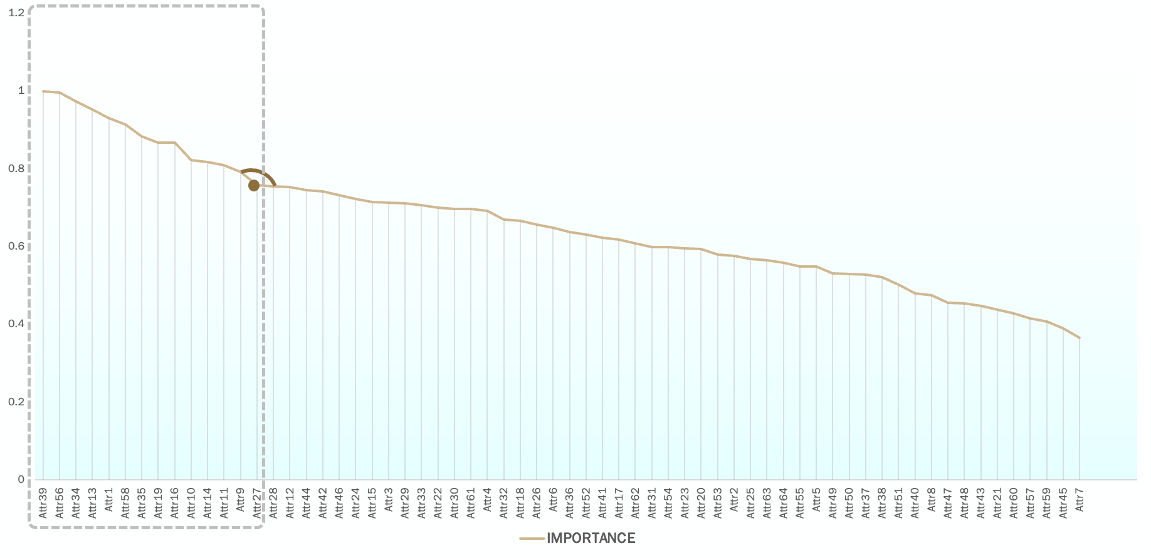
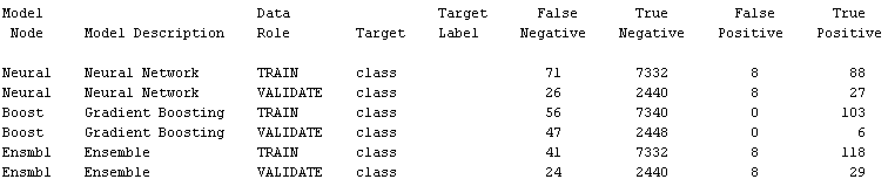

How do we interpret the output?
Gradient Boost - Model Output (Sample)
Scree Plot – Interpret import variables
Variable Importance >= 0.9 (Top 6)
Event Classification Table
Sales Profitability - Profit on sales / sales - Attr39
Sales Efficiency - (Sales - cost of products sold) / sales - Attr56
Operational Leverage - Operating expenses / total liabilities - Attr34
Profitability Ratio - (Gross profit + depreciation) / sales - Attr13
Asset Profitability - Net profit / total assets - Attr1
Cost to Sales Ratio - Total costs / total sales - Attr58
Other Scope
Adjust Cutoff values to minimize False positives
Try using more models in ensemble for better interpretability
Objective
Approach
Best
Model
Interpret
Learnings
Notes:
The Neural Network seems to have a moderate performance, with some false negatives (cases where the model incorrectly predicts non-bankruptcy). The number of false positives remains consistent in both training and validation, indicating a stable but possibly conservative model.
The Gradient Boosting model has an excellent performance on the training data with no false positives; however, it appears to have overfitted to the training data, as evidenced by the decreased performance in the validation data (only 6 true positives).
The Ensemble model shows the best performance in terms of true positives on the training data, suggesting that it combines the strengths of different models to achieve higher sensitivity. On the validation data, it also outperforms the single models in identifying true positives, suggesting a good balance between sensitivity and specificity.
Overall, the Ensemble model demonstrates the best generalization to the validation data, indicating robust performance. It maintains a good balance by achieving the highest true positives and lowest false negatives on the validation data compared to the other models, suggesting a better ability to correctly identify bankruptcy cases without sacrificing accuracy on non-bankruptcy predictions.

Slide 7
What have we learnt from this project?
Experiential learning of SEMMA approach in building Predictive models
Various Data Pre-processing techniques
Building predictive models and Identifying the best model through Model comparison
Interpretation of different kinds of models
Hands-on Experience on SAS Enterprise Miner
Exposure to Kaggle Data competitions
Objective
Approach
Best Model
Interpret
Learnings

Slide 8
Thank you!

